Slide 1
Decomposition
Introduction to computational thinking

Slide 2
What is decomposition?
“Decomposition is the process of breaking down data. It can include a number of processes or steps necessary in order to solve the problem. By decomposing the problem, we can identify the components, or smaller parts, of the problem before we generalize the pattern.
Through decomposition, we can identify and solve one case in order to then generalize those steps to all possible instances of the problem”
- Applied Computational Thinking with Python, Packt, 2020, p. 33

Slide 3
Examples
Academic research paper includes: literature review, data collection, analysis, drafting, and editing
Programming a robot to navigate a maze: sensing the environment, deciding a direction, moving forward, and handling obstacles

Slide 4
Examples (cont.)
Prepare for a party: buy food, cooking, make table, invite guests…
Travel plan: buy plane tickets, booking, prepare luggage, find restaurants…

Slide 5
Principles of decomposition

Slide 6
1. Break problems into meaningful, functional parts
Each part should represent a logical unit of work
Avoid over-decomposition (too many trivial subtasks) and under-decomposition (tasks too large)

Slide 7
2. Clear inputs and outputs
A subproblem must specify what data it receives and what it produces.
This supports modularity and independent implementation.

Slide 8
3. Maintain independence and loose coupling
Subtasks should minimize unnecessary dependencies.
Highly coupled tasks increase complexity and error propagation.

Slide 9
4. Preserve coherence and single responsibility
Each subtask should do exactly one thing well.
Ensures clarity, maintainability, and easier debugging.

Slide 10
5. Optimize for reuse
Components should be general enough to be reused across similar problems or contexts.

Slide 11
6. Align with user needs and problem goals
Every subtask must contribute directly to solving a real requirement or pain point.

Slide 12
7. Keep decomposition flexible
Problems evolve → decomposition must be revisited and refined.

Slide 13
Methods of decomposition

Slide 14
Core ideas
Top-down design
Start from the high-level goal → divide into modules → divide into functions → divide into steps.
Modularization
Split the system into independent modules: input, processing, output…
Workflow mapping
Draw workflow diagrams (flowchart, BPMN) to clarify each step.
Divide-and-Conquer
Algorithm strategy: break into smaller parts → solve each part → combine results.

Slide 15
1. Functional decomposition
Break the problem along functional boundaries:
Input processing
Transformation
Output generation
Common in software engineering and algorithm design.

Slide 16
2. Data-flow decomposition
Split based on how data moves through the system.
Identify stages of data transformation.
Great for pipelines (ETL, ML workflows, compiler design).

Slide 17
3. Goal-oriented (top-down) decomposition
Start with high-level goals and break them into subgoals → actions.
Similar to task analysis and hierarchical planning.

Slide 18
4. Bottom-up decomposition
Identify reusable building blocks first.
Assemble them into larger components.
Useful when existing modules or libraries shape the architecture.

Slide 19
5. Event-based decomposition
Break by events and reactions.
Common in GUI systems, agents, robotics, and real-time applications.

Slide 20
6. Object-oriented decomposition
Identify objects, responsibilities, and interactions.
Break tasks around class behavior and domain entities.

Slide 21
7. Scenario-based decomposition
Use user stories, use cases, or scenarios.
Decompose tasks based on workflows users actually perform.

Slide 22
8. Constraint-driven decomposition
Break problem according to constraints: timing, resources, safety, performance.
Typical in embedded systems, hardware design, optimization problems.

Slide 23
Tools for decomposition

Slide 24
1. Diagramming Tools
Flowcharts
Data Flow Diagrams (DFD)
UML:
Activity diagrams
Sequence diagrams
Component/Class diagrams
Block diagrams: Helps visualize structure, dependencies, and responsibilities.

Slide 25
2. Analysis Tools
Dependency graph / DAG
Input–Output tables
Functional hierarchy charts
Task and subtask matrices: Used to validate correctness, order, and interfaces.

Slide 26
3. Knowledge Engineering Tools
Problem frames: Goal models (KAOS, i Framework)*
Use case maps: Helps ensure decomposition matches real requirements.

Slide 27
4. Software Engineering Tools
Issue trackers / Kanban boards (Jira, Trello, GitHub Projects)
Modularization tools (package managers, build systems)
Code analysis tools (to inspect coupling, cohesion)

Slide 28
5. Computation Tools
Pseudo-code editors
Algorithm design tools (VisuAlgo, draw.io, Mermaid)
Notebooks (Jupyter, Colab) for prototyping modular algorithms.

Slide 29
6. Collaboration Tools
Shared diagrams (Miro, FigJam)
Documentation systems (Notion, Confluence, Obsidian)
Version control (Git) for managing modular codebases.

Slide 30
Quick checklist
Decompose along function, data flow, or user goals
Define input/output for each subproblem
Maintain loose coupling, high cohesion
Visualize using diagrams and dependency graphs
Validate each subtask with testable criteria
Prioritize decomposition based on pain points and constraints
Continuously iterate and refine as requirements evolve

Slide 31
Artifacts of decomposition

Slide 32
1. Problem Statement (Refined)
A clearer, structured restatement of the original problem after initial analysis.
Includes constraints, goals, assumptions, and success criteria.

Slide 33
2. Functional Breakdown / Work Breakdown Structure (WBS)
A hierarchical representation of the problem split into:
Systems
Subsystems
Functions
Tasks
Subtasks
Often visualized as a tree.

Slide 34
3. Input–Output Specification for Each Subtask
Document that defines:
Input(s)
Output(s)
Preconditions
Postconditions
Data formats
Critical for making tasks independently implementable.

Slide 35
4. Decomposition Tree / Hierarchy Diagram
Functional decomposition tree
Task hierarchy
Subproblem tree
Shows how high-level tasks map to smaller chunks.

Slide 36
5. Data Flow Diagram (DFD) or Pipeline Diagram
Visualizes how data moves through each component:
Inputs
Processing stages
Outputs
Stores
Useful for computational and ML pipeline decomposition.

Slide 37
6. Dependency Graph
A Directed Acyclic Graph (DAG) showing:
Which subtask depends on which
Execution order
Parallelizable tasks
Prevents wrong-order design or circular dependencies.

Slide 38
7. System Architecture Sketch
A lightweight architectural overview after decomposition:
Modules
Boundaries
Interfaces
Communication patterns
May be drawn as UML, block diagrams, or simple boxes & arrows.

Slide 39
8. Interface Contracts / API Specs
Clear definitions of:
Function signatures
REST endpoints
Class boundaries
Message formats
These ensure subtasks integrate properly.

Slide 40
9. Solution Outline / Pseudocode
A high-level algorithm that uses the decomposed subtasks in sequence.
Acts as a bridge between decomposition and implementation.

Slide 41
10. Validation & Test Plan Per Subtask
Includes:
Unit tests
Success criteria
Error conditions
Acceptance tests
Ensures each piece is independently testable.

Slide 42
11. Assumptions, Constraints, and Trade-off Notes
Documentation of:
What assumptions each subtask relies on
Constraints (time, performance, resources, API limits)
Trade-offs made during decomposition
Useful for review and future revisions.

Slide 43
12. Mapping to User Requirements / Pain Points
A traceability table:
Subtask Requirement - Pain Point - Value Delivered
Ensures all decomposed parts serve a real purpose.

Slide 44
13. Activity Diagrams
For modeling workflow logic.

Slide 45
14. Sequence Diagrams
For modeling interaction between subtasks or objects.

Slide 46
15. Prototype Modules
Small prototype implementations for risky or unclear components.

Slide 47
16. Decomposition Review Checklist
A list used by teams to evaluate whether the decomposition is sound.

Slide 48
Problems of decomposition

Slide 49
1. Over-decomposition
Splitting the problem into too many tiny parts → losing control and making the system more complicated instead of simpler.
Example: in a Smart Travel System, breaking “Create itinerary” into 20 micro-subtasks (create day 1, pick spot 1, pick spot 2, …) makes management difficult.
Symptoms:
Easy to lose track of dependencies
Integration takes too much time
Documentation becomes lengthy and confusing

Slide 50
2. Under-decomposition
Keeping the problem at too high a level → difficult to implement and debug.
Example: only writing “Optimize itinerary” without splitting it into subtasks such as: route optimization, cost optimization, travel time optimization.
Consequences:
Complex code/algorithm
Hard to test each part
Risk of slow development or going in the wrong direction

Slide 51
3. Undefined input-output for subtasks
Each small part must have clear input and output.
Without them, subtasks depend on each other in unclear ways, making independent implementation difficult.
Example: “Optimize route” without specifying that the input is the list of destinations and travel date, and the output is the ordered list → ambiguity.

Slide 52
4. Illogical / non-functional decomposition
Splitting based on random ideas instead of functional logic / data flow / features.
Consequence: disconnected subtasks that are hard to integrate.
Example: dividing “Create itinerary” by “each developer handles one day” instead of by task logic → messy code, hard to maintain.

Slide 53
5. Poor dependency / execution order management
Subtasks often depend on each other.
Without a dependency graph, it’s easy to build in the wrong order or work on a subtask before its required output exists.

Slide 54
6. Ignoring non-functional requirements / constraints during decomposition
Focusing too much on logic/function → forgetting performance, scalability, UX.
Example: “itinerary suggestion” doesn’t consider load time or API limits → fast prototype but problematic in real deployment.

Slide 55
7. Forgetting validation / testing when decomposing
Splitting tasks without defining success criteria for each subtask → difficult to test them independently.
Example: “calculate tour cost” without specifying ±5% accuracy threshold → ineffective testing.

Slide 56
8. Subtasks not linked to pain points / user needs
Subtasks are created but no one knows which pain point each one solves → may build unnecessary features.
Example: generating a “beautiful itinerary” but not reducing the time users spend planning → doesn’t solve any pain point.

Slide 57
9. Poor communication / documentation
When decomposing tasks for the team, lacking diagrams, checklists, flowcharts leads to different interpretations → logic errors, duplicate work.

Slide 58
10. Not adjusting decomposition when the project changes
Problems or requirements can change → rigid decomposition becomes outdated.
Always keep decomposition flexible and updatable.

Slide 59
Tips to avoid decomposition issues
Split by logical / functional modules, not by days or by people.
Ensure each subtask has clear input–output.
Keep decomposition at a balanced level: not too small, not too large.
Draw a dependency graph / data flow before implementation.
Link subtask ↔ pain point ↔ requirement.
Define success criteria / testability for every subtask.
Continuously review & refactor the decomposition as requirements evolve.

Slide 60
Smart travel system

Slide 61
1. User Management
Login / Signup
Profile Management
Preferences / Interests

Slide 62
2. Travel Planning
Input Preferences & Dates
Generate Itinerary
Select Destinations
Optimize Route <-- (Dependency: Select Destinations)
Suggest Hotels & Tours <-- (Dependency: Destinations)
Budget Estimation
Share / Save Itinerary

Slide 63
3. Booking Services
Hotel Booking
Flight Booking
Tour Booking
Payment Gateway Integration

Slide 64
4. Map & Navigation
Route Visualization <-- (Dependency: Optimize Route)
Offline Maps
Real-time Traffic Updates

Slide 65
5. Admin / Backend
Destination Data Management
Tour / Service Management
Analytics & Reporting

Slide 66
6. External APIs
Maps API
Weather API
Booking APIs

Slide 67
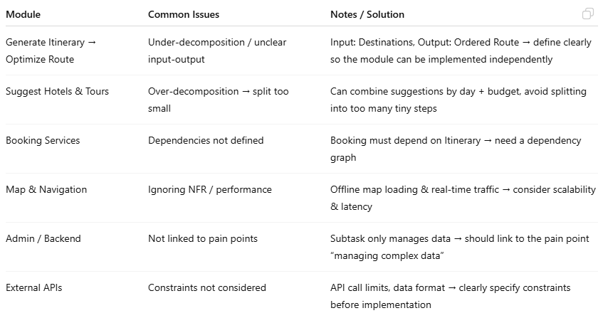
Common problems

Slide 68
Tips
Each submodule → include Input – Output labels
Use dependency arrows to show which subtask depends on which
Attach pain point references to each subtask → ensure every module addresses real user problems
Mark risks / constraints directly on the diagram

Slide 69
Discussion

Slide 70
Discussion
Imagine a team of students developing a simple game: Caro.
How could the project be decomposed into parts?
Criteria:
Clarity
Independence of components
Missing components?
Overlapping components?

Slide 71
Suggestion
They can decompose the project into parts: game logic, graphics, user input, and testing.
Each team member takes ownership of one part

Slide 72
Exercise

Slide 73
Decomposition
Find sub-problems or components for
A course registration system

Slide 74
Suggested answer
Student authentication
Course search
Schedule conflict checking
Enrollment
Waitlist management

Slide 75
Tools

Slide 76
Diagrams
UML Class diagram: classes, attributes, methods, relationship (agrregation, composition, inheritance)
UML Package diagram
Architecture diagram: frontend, backend, db, services…
C4 diagram
Context: system & related users
Container: application & main services
Component: modules insides each container
Code: classes, file

Slide 77
Suggested tools to create diagram
mermaid.live
draw.io

Slide 78
Task decomposition Work breakdown structrure

Slide 79
WBS: what to do & how the work is organized
Level 1 – Project: Smart Parking System
Level 2 – Major Deliverables:
Requirements Analysis
System Design
Implementation
Testing
Deployment

Slide 80
Level 3 – Subtasks
Under System Design:
UI/UX Design
Database Schema Design
API Specification
Under Testing:
Unit Testing
Integration Testing
User Acceptance Testing

Slide 81
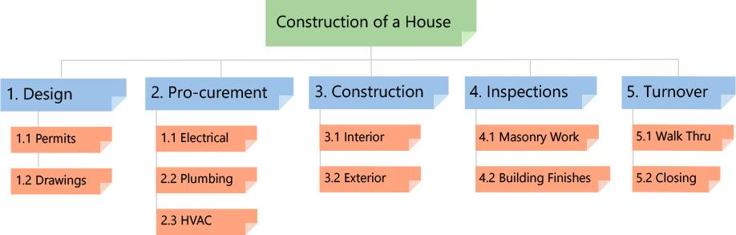
Example Phase-Based Work Breakdown Structure
https://www.workbreakdownstructure.com

Slide 82
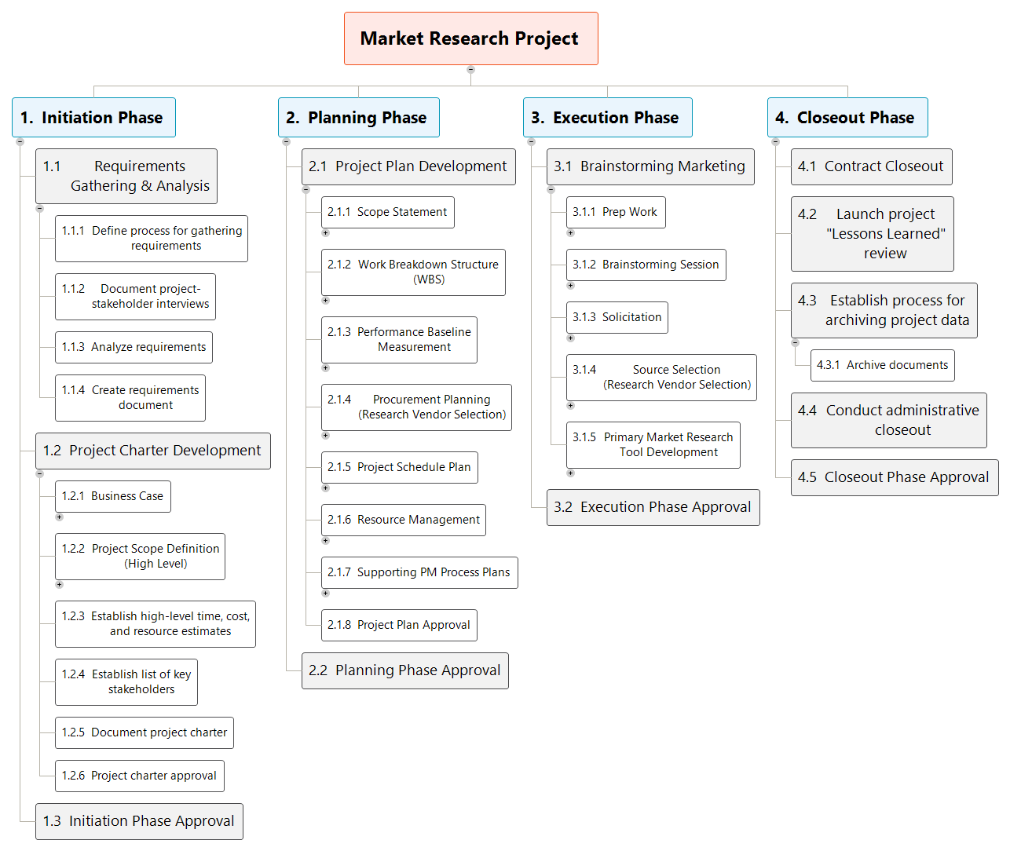
Example Market research
WBS Examples & Templates | workbreakdownstructure.com (& a lot of examples)

